Slide 1

Investment project evaluation model based on fuzzy control system
Chernyshova V.V.
Korchynskyi V.V.
Faculty of Information Systems and Technologies, KNEU, Ukraine

Slide 2

MAIN AIM
Scientific research upon fuzzy control systems was carried out. A draft/model of our own system that is based on previously revised knowledge concerning fuzzy models was introduced. Moreover, some ideas upon modification of such models were given and a modified version was proposed. As a subject area for this model a decision-making process regarding investment projects was chosen

Slide 3
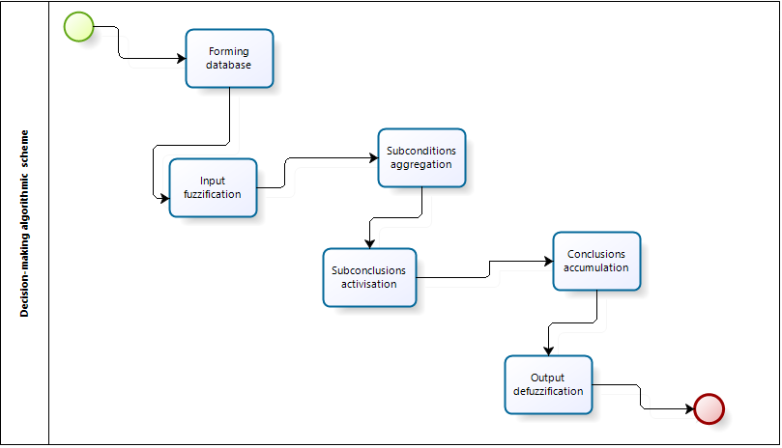

General fuzzy control model is based on the need of the implementation of all fuzzy conclusions stages and the process of this conclusion is implemented on the basis of the fuzzy conclusion algorithm.
Fuzzy conclusion system is designed to convert the value of input variables into process control output variables using fuzzy rules. This system has to include fuzzy rules base and to provide fuzzy conclusion based on references or conditions that are presented in a fuzzy linguistic reference form. The transition from fuzzy conclusion to the precise (unfussy) solution is shown in algorithmic form
Decision-making algorithmic scheme

Slide 4
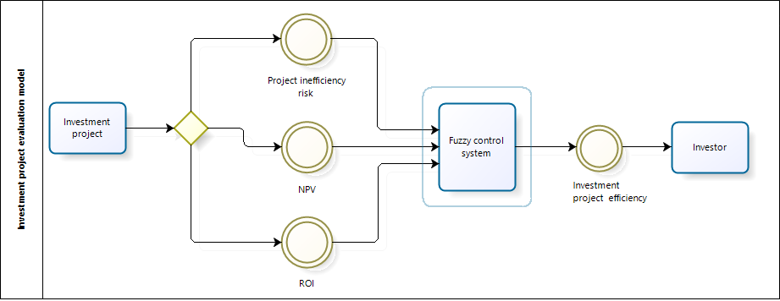

In order to understand this process better, we can present an example, based on making a decision about choosing the most efficient investment project
Investment project evaluation model

Slide 5

First of all, linguistic analogues must be inserted in place of precise input variables. Number of terms is set for each parameter (for example, two possible terms: high or low). Output variables will be presented in such set of terms: inefficient, efficient and moderately efficient.
After setting all of linguistic variables, we are going to form fuzzy rules base. Fuzzy rules base for output is a final set of fuzzy output rules that are coordinated with linguistic variables.
Rules
1. If (PIR is High) and (NPV is High) and (ROI is High) then (IPE is Moderately Efficient)
2. If (PIR is Low) and (NPV is Low) and (ROI is Low) then (IPE is Moderately Efficient)
3. If (PIR is High) and (NPV is Low) and (ROI is Low) then (IPE is Inefficient)
4. If (PIR is Low) and (NPV is High) and (ROI is High) then (IPE is Efficient)
Rules for investment project evaluation model

Slide 6

As we can see, in the result we have only 4 rules as we deducted from the whole set of rules another 4, that were economically inappropriate
According to a fuzzy conclusion algorithm the next stage is a process of fuzzification where accordance is set between each particular value of input variable of fuzzy control system and it`s adequate input linguistic variable`s term. After finishing that procedure specific values of membership function on all linguistic terms are set for all input variables
Membership function for all input and output variables of specific regulator will be based on fundamental functions of MATLAB package. For input variables PIR (Project Inefficiency Risk), NPV (Net Present Value), ROI (Return On Investment) and for output variable IPE (Investment Project Efficiency) sets of trapezoidal and triangular membership functions (which have a clear geometrical representation) will be used

Slide 7
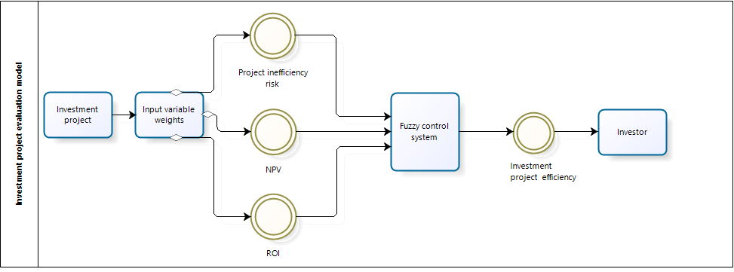

Due to our science research, we found out that the designed model can be improved in many different ways. In order to improve given model we suggest modifying it with parameter weights. This option helps to make the process more accurate and the model becomes more flexible and responsive to investor`s preferences. How does it work? User define which of parameters is the most important for him by inputting weights for all parameters. Weight`s value may vary from 0 to 1. Sum of all weights must be equal precisely 1. Using conditional function and according to parameters` weight, system chooses a specific set of rules which is manually put in and that is saved previously in the system as a default. In this situation our model will be changed as it is shown on the following picture
Modified investment project evaluation model

Slide 8

To summarize, we looked through the definition of fuzzy control system. We created a draft/model of our own system that is based on previously revised knowledge concerning fuzzy models. In addition, some ideas upon modification of such models were given and a modified version was presented. Subject area that was chosen for this model is decision-making process regarding investment projects. Development of such kind of fuzzy control system models has significant impact on the efficiency of decision-making process in different areas

Slide 9



