Slide 1
RISK MANAGEMENT IN TERMS OF BIG DATA
V. Bagnyuk, L. Vynnytska

Slide 2
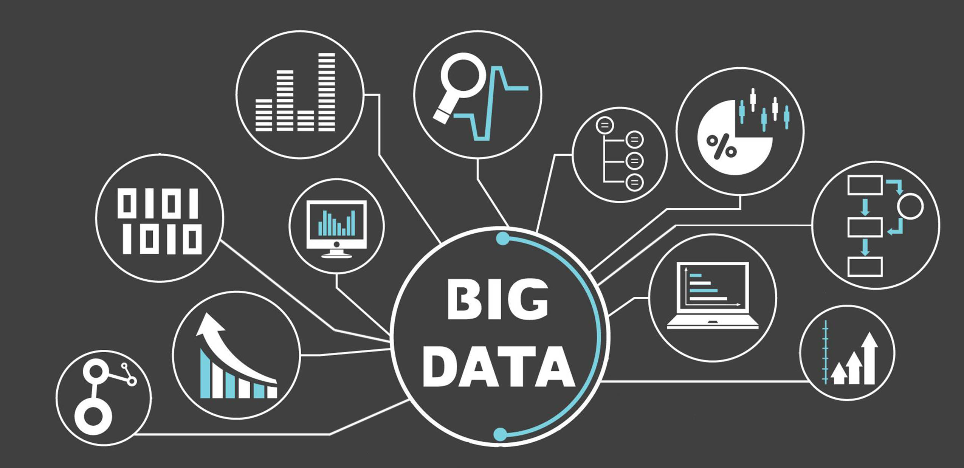
WHAT IS BIG DATA?

Slide 3
WHY BIG DATA
Key enablers of appearance and growth of Big Data are:
- Increase of storage capacities
- Increase of processing power
- Availability of data
- Every day we create 2.5 quintillion bytes of data — so much that over 80% of the data in the world today has been created in the last two years alone.

Slide 4
BIG DATA IN TERMS OF RISK MANAGEMENT
Big Data is routinely defined as high-volume, high-velocity and high-variety information assets demanding new technological approaches to organization and analysis. When applied to risk management within the financial services industry, ‘high-veracity’ and ‘high-value’ would be add to this list - effective analysis of this data has the potential to drive increased accuracy and reliability, and offers potentially significant cost savings by combatting the risks that can cost financial institutions billions.

Slide 5
IMPACT OF BIG DATA ON RISK MANAGEMENT AND DECISION-MAKING

Slide 6

Jason Hill
Executive Partner - Reply
‘Time is critical in the new world of risk management. If you can react to a risk faster, you have a competitive advantage’

Slide 7
NEW GENERATION ANALYTIC SYSTEMS
Business analytic systems for large data volumes are very different from traditional analytical systems due to algorithms and system resources required. These differences exist because of the requirement to reduce the number of computational resources and at the same time provide access to the analytical system results as soon as possible.
Unlike traditional analytical systems, new generation systems produce knowledge practically in real time. These systems help to gain more competitive knowledge in specialized areas, and manage resources better; they successfully cope with huge data sets.

Slide 8
TAKEAWAYS
Big Data represents the future in the field of risk management. Already used widely across other sectors - particularly in eCommerce – Big Data is a true game changer. As for Ukraine, It would be a significant advantage for our native risk management organizations to use these latest technologies. Big Data technologies are set to transform the world of risk management.

Slide 9
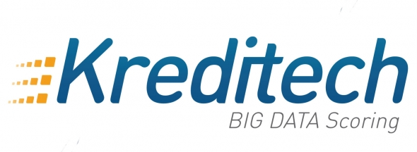



International corporations implement Big Data technologies in their practice

Slide 10

THANK YOU FOR ATTENTION

