Slide 1
IMPACT ON THE INDEX OF INNOVATIVE DEVELOPMENT SPENDING ON EDUCATION AND PURCHASING MANAGERS INDEX
Salimgareeva Lira Ergisovna
third rate student
financial and economic department
Financial university at Government of Russian Federation,
Russia

Slide 2
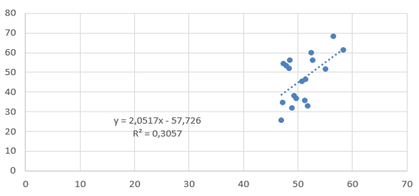
The regression model based on the GII PMI to 19 countries

Slide 3
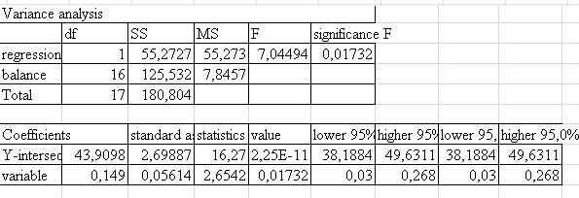
Fig. 1. The data of variance and regression analysis model

Slide 4
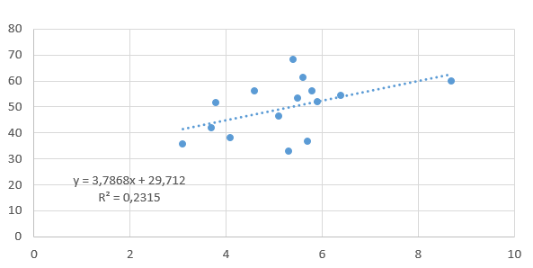
GII dependence of expenditure on education

Slide 5
Conclusions:
Russia this year ranked 49th in the overall ranking, between Thailand (48) and Greece (50), up on 13 positions immediately:
The strengths of Russia related with quality of human capital (30th place), Business Development (43), the development of knowledge and technology (34).The Indicators of infrastructure development remain at an average level (51 seats). Factors that hinder development of innovations imperfect institutions (88th place), the low results of creative activity (72) and the development of the internal market (111) [2].
Taken sanctions against Russia as stimulate the development of purchasing managers index and innovation projects. This allows us to be optimistic about the prospects for Russia's innovative development and economic recovery.

